Slide 1
Java 8 StringJoiner class, String.join() method
momedaram

Slide 2
Joining or concatenating the strings is the frequent operation while programming any kind of applications.
java.util.StringJoiner class
String.join() method
By using these, we can join an array of strings or a list of strings or simply string elements separated by a mandatory delimiter and optional prefix and suffix.
Notes:
To make this process easy and efficient, Java API developers has introduced

Slide 3
StringJoiner
StringJoiner class internally uses StringBuilder class to join the strings.
java.util package.
Using StringJoiner, we can join only the strings, but not the array of strings or list of strings.
StringJoiner Constructors:
1. StringJoiner s = new StringJoiner(CharSequence delimiter);
2. StringJoiner s = new StringJoiner(CharSequence delimiter, CharSequence prefix, CharSequence suffix);

Slide 4
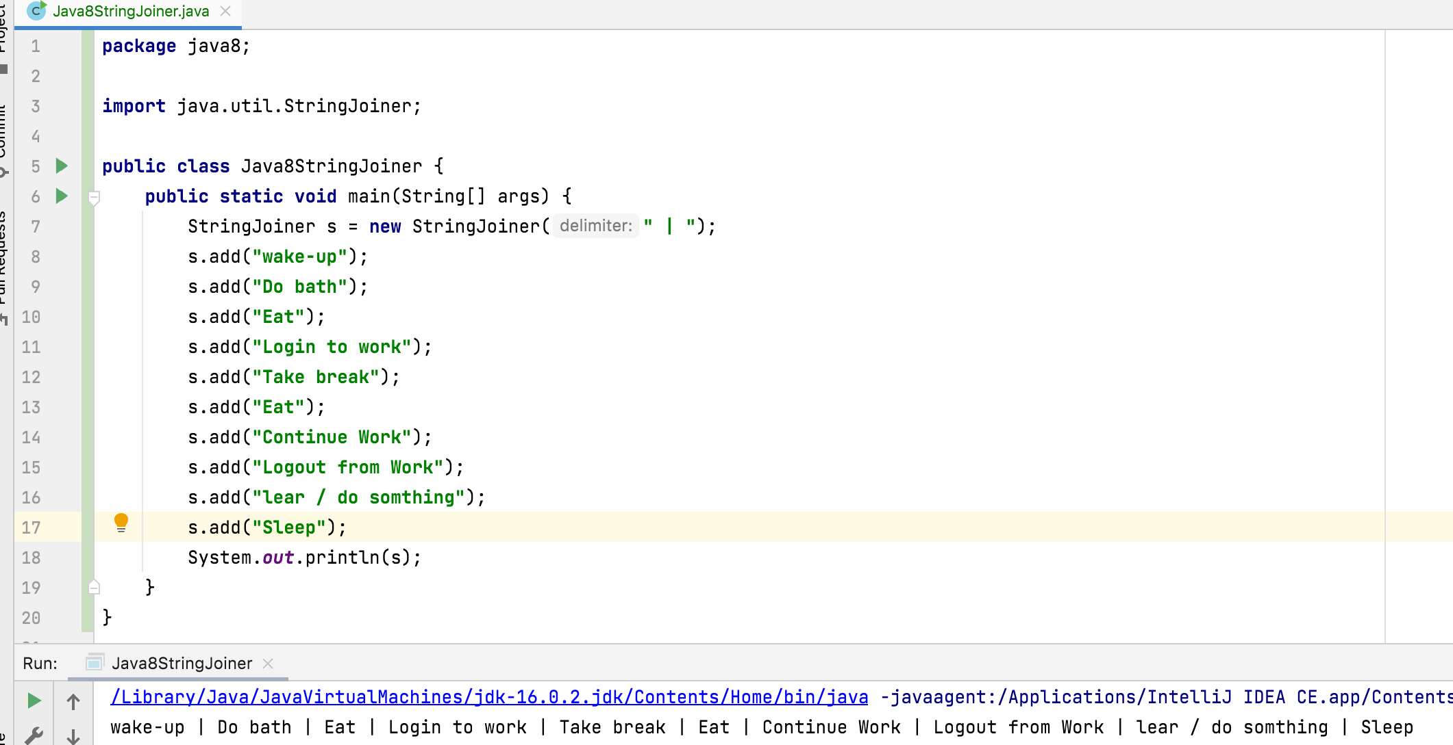
StringJoiner s = new StringJoiner(CharSequence delimiter);

Slide 5
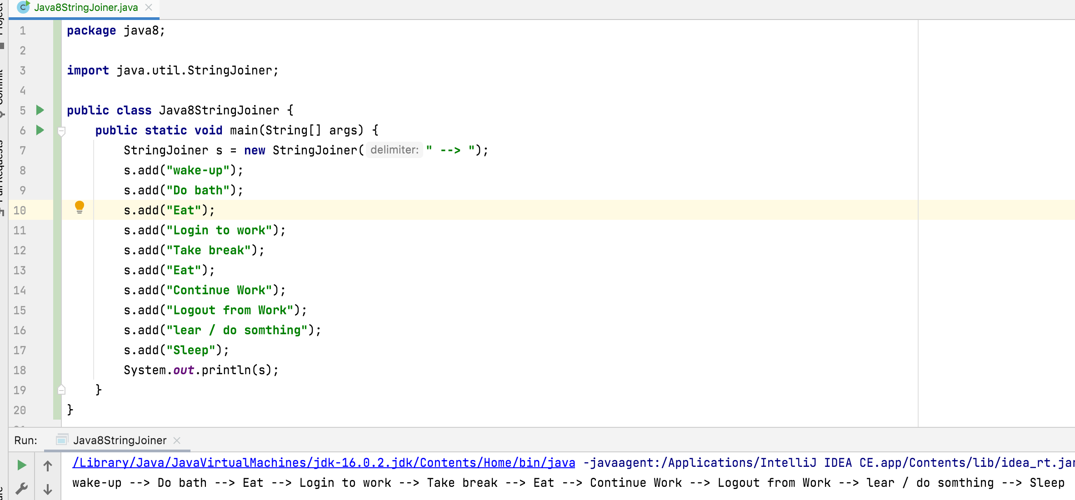
StringJoiner s = new StringJoiner(CharSequence delimiter);

Slide 6
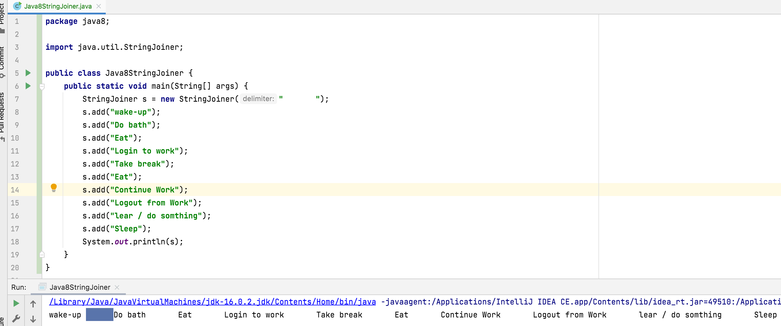
StringJoiner s = new StringJoiner(CharSequence delimiter);

Slide 7
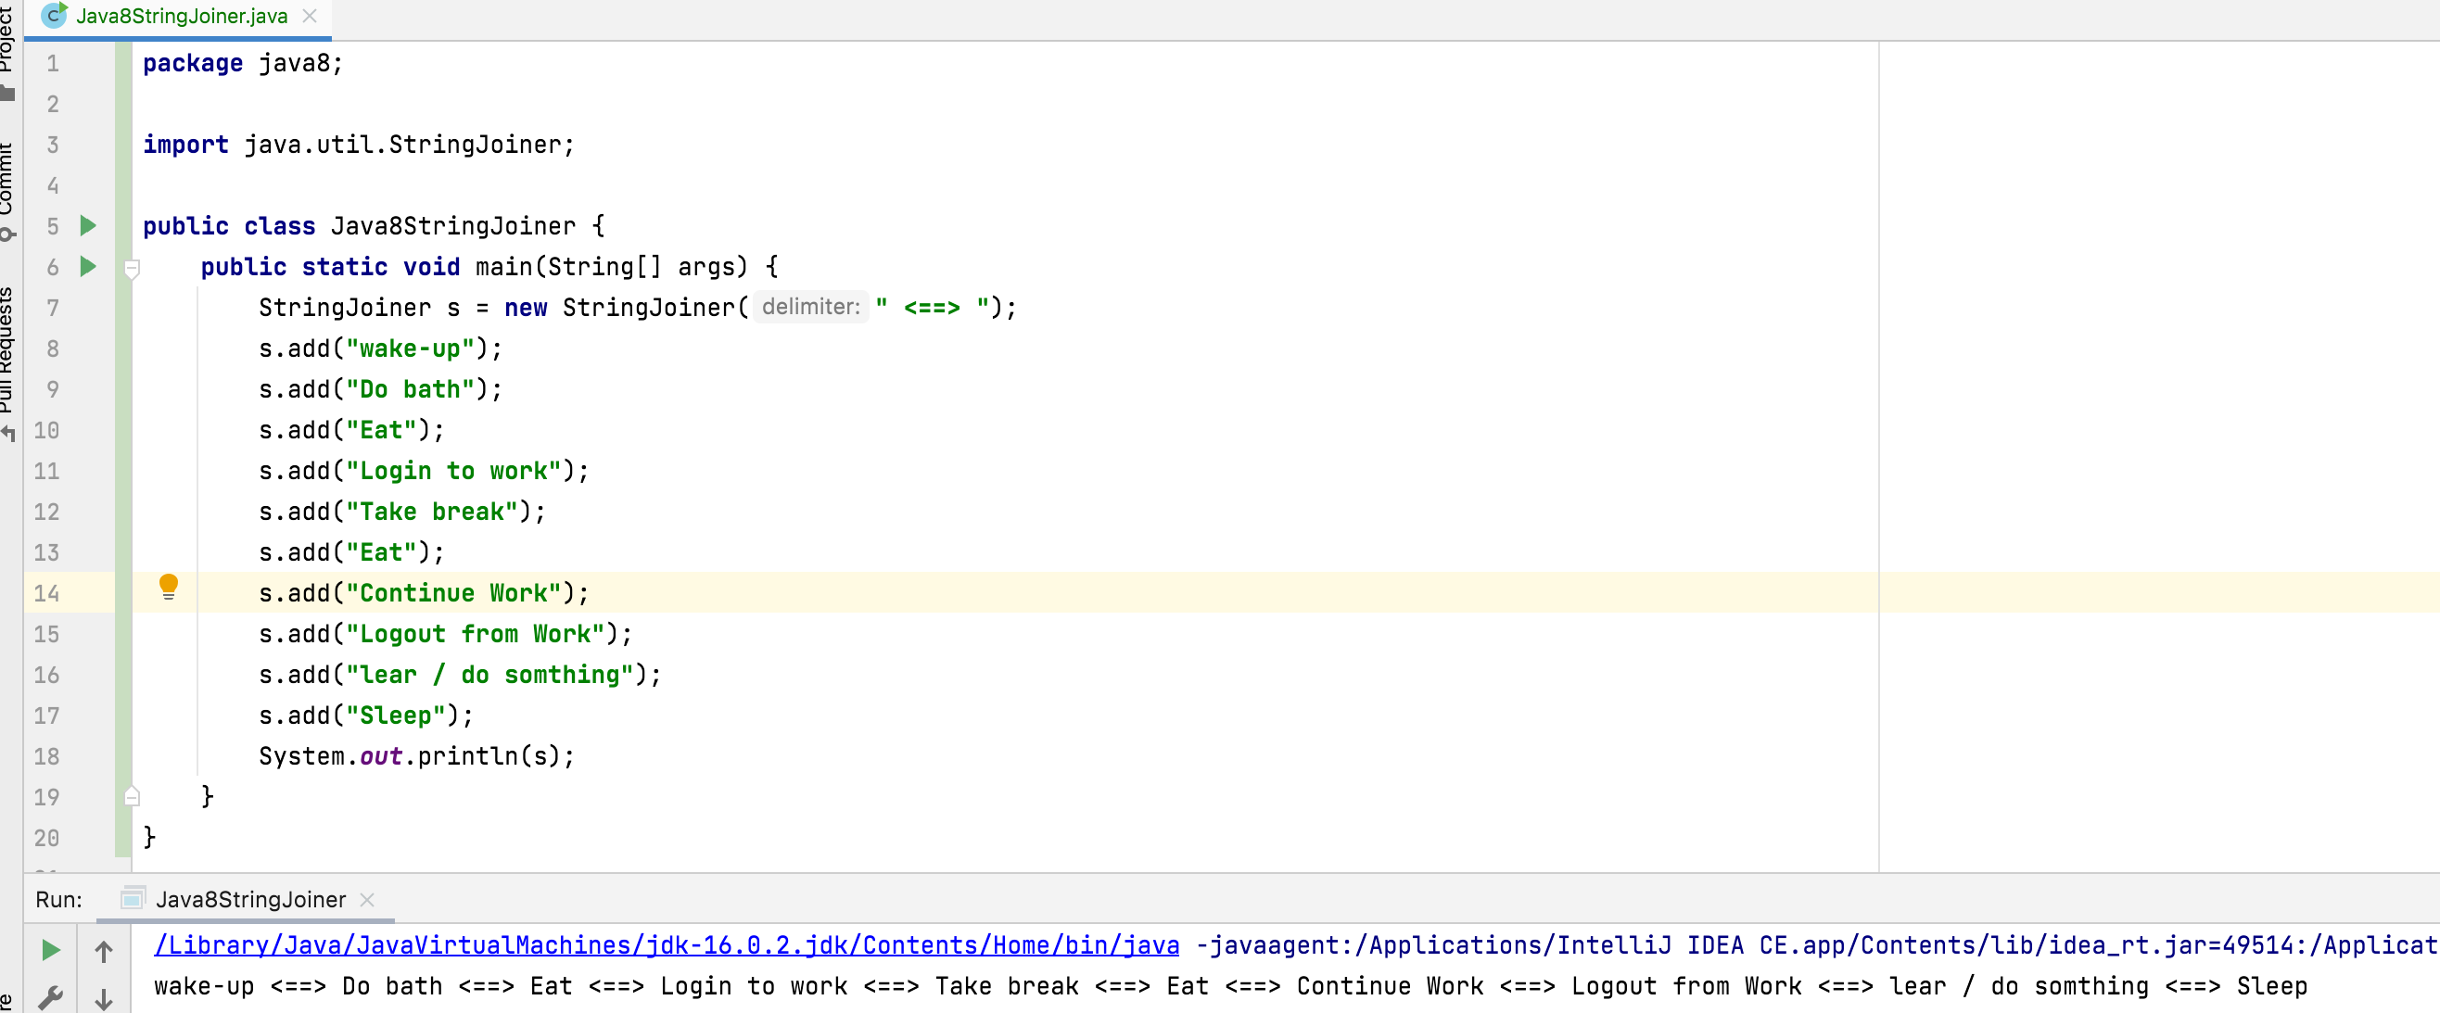
StringJoiner s = new StringJoiner(CharSequence delimiter);

Slide 8
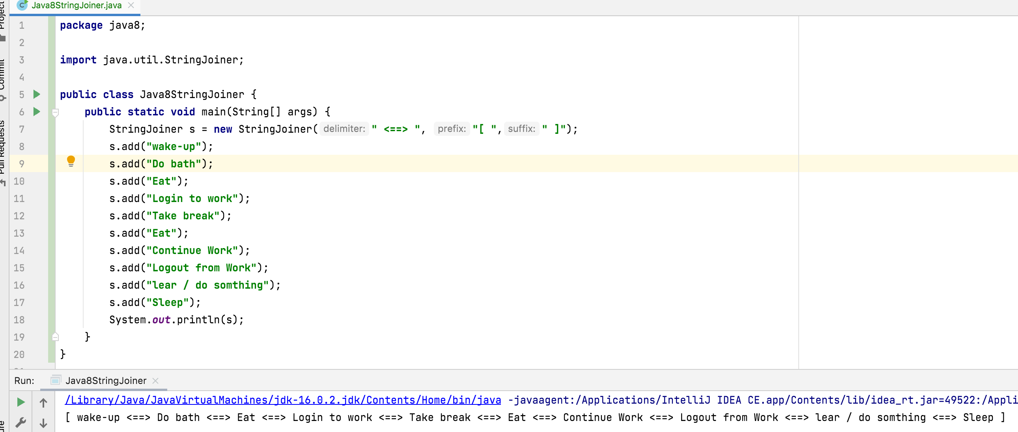
StringJoiner s = new StringJoiner(CharSequence delimiter, CharSequence prefix, CharSequence suffix);

Slide 9
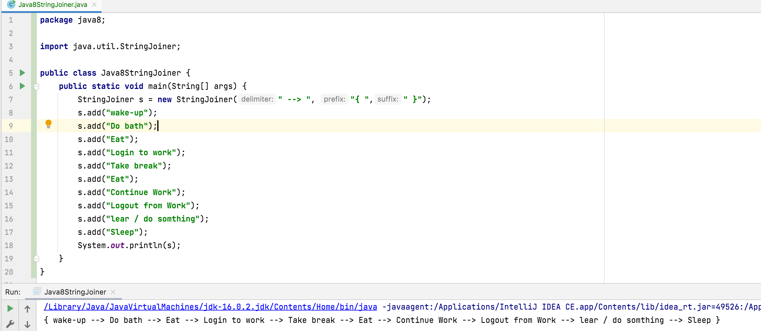
StringJoiner s = new StringJoiner(CharSequence delimiter, CharSequence prefix, CharSequence suffix);

Slide 10
String.join() Method
join() method internally uses StringJoiner class.
This method can be used to join strings or array of strings or list of strings, but only with delimiter not with prefix and suffix.
a) public static String join(CharSequence delimiter, CharSequence… elements) b) public static String join(CharSequence delimiter, Iterable<? extends CharSequence> elements)

Slide 11
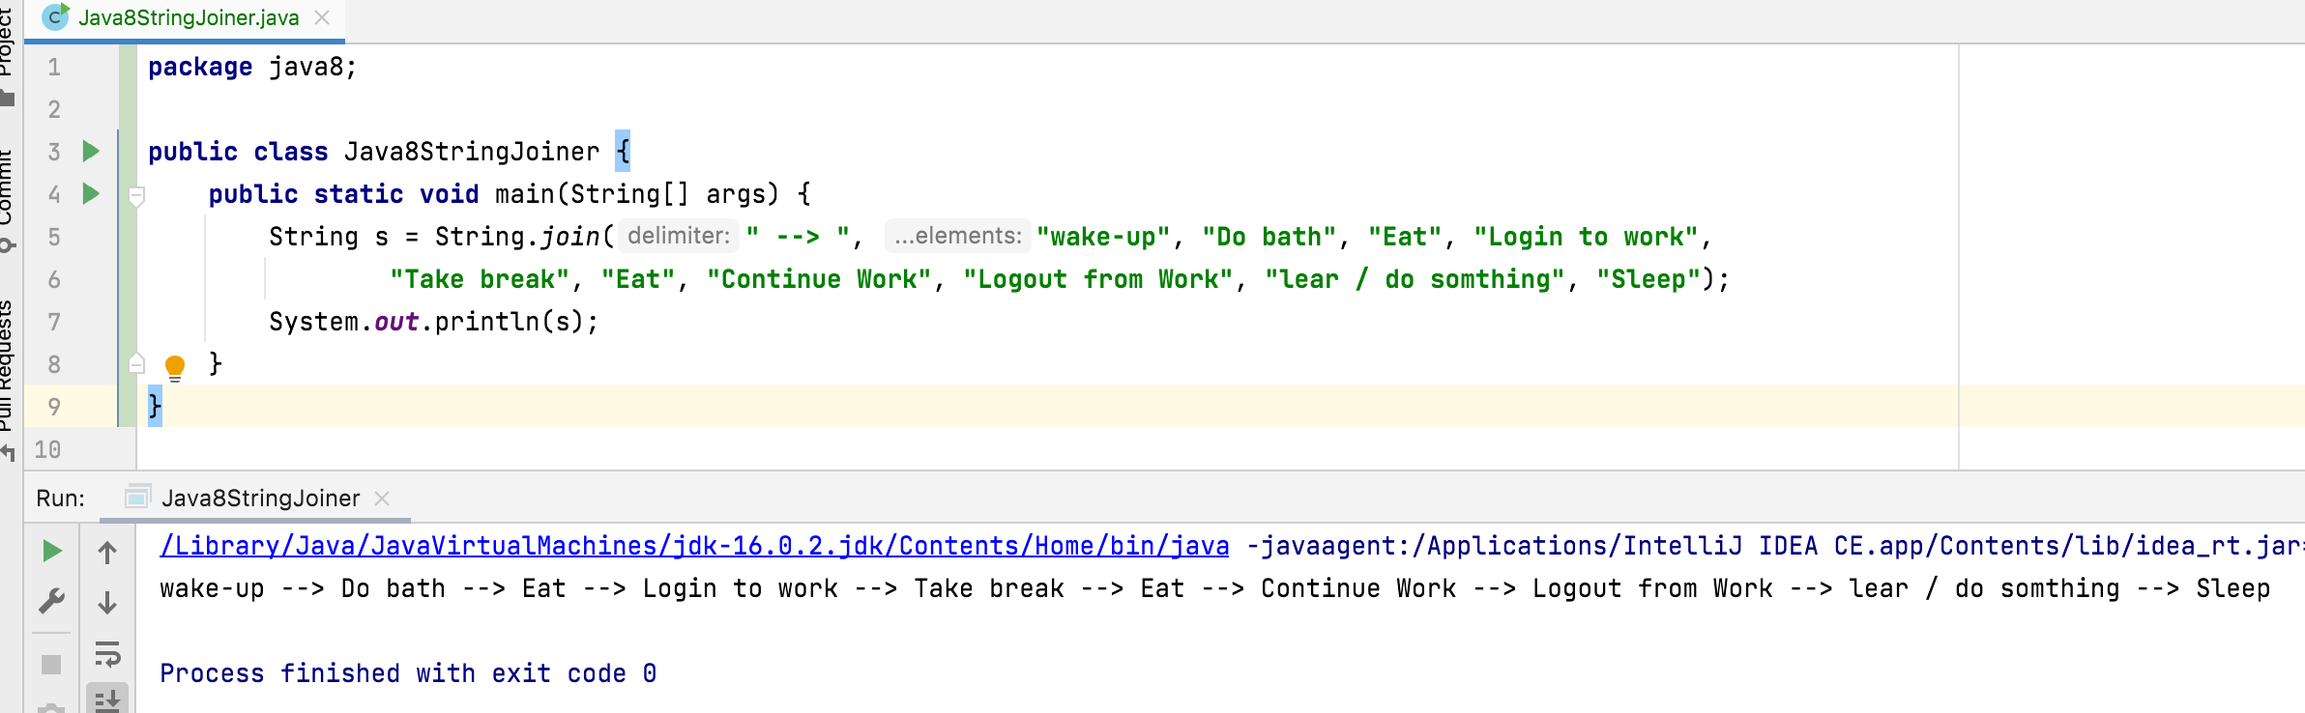
public static String join(CharSequence delimiter, CharSequence… elements)

Slide 12
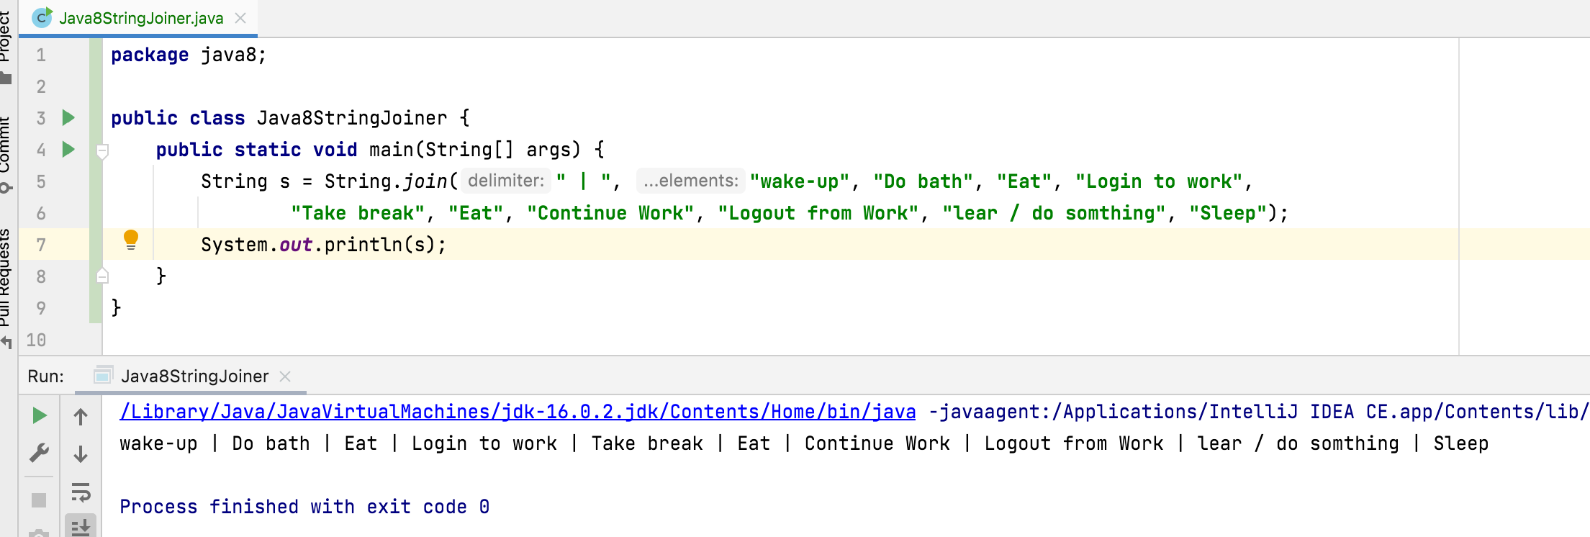
public static String join(CharSequence delimiter, CharSequence… elements)

Slide 13
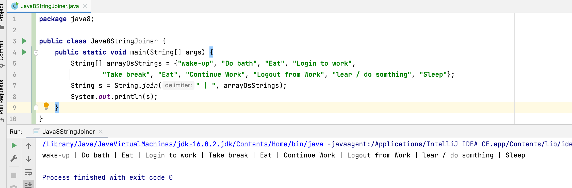
public static String join(CharSequence delimiter, Iterable<? extends CharSequence> elements)

Slide 14
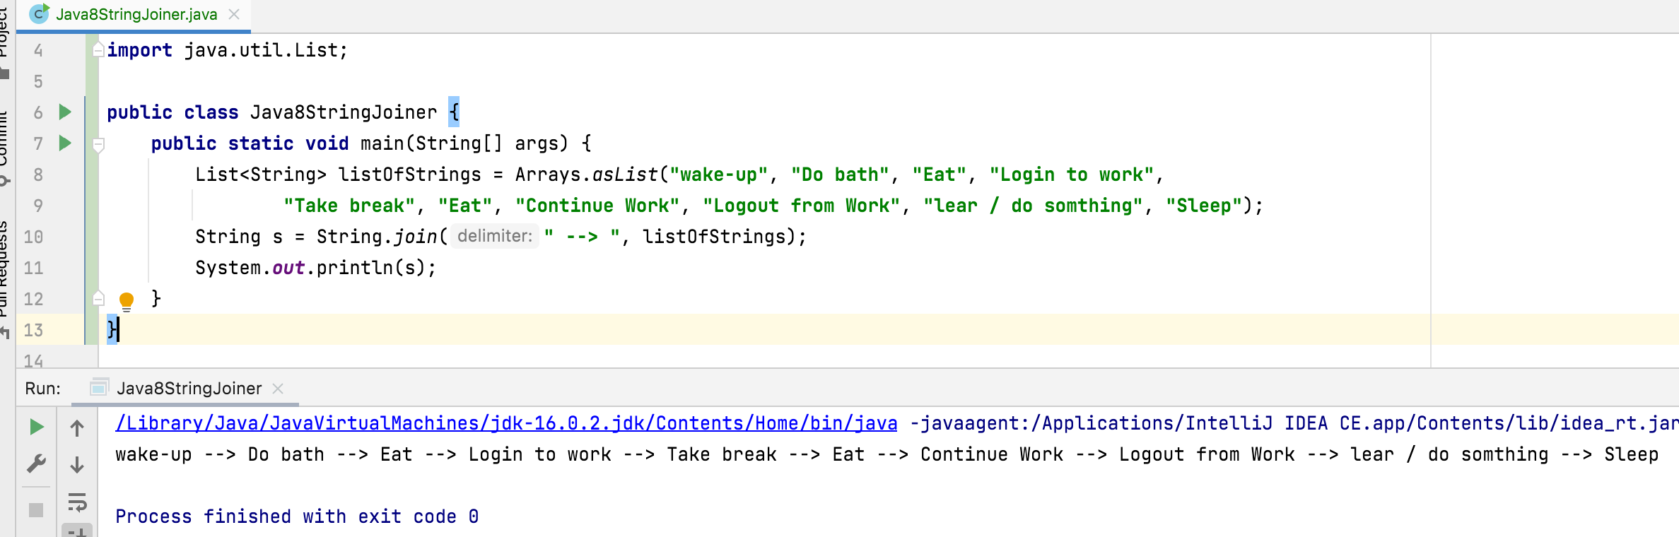
public static String join(CharSequence delimiter, Iterable<? extends CharSequence> elements)

Slide 15
Thank You !
momedaram

